Slide 1
UNIVERSITY INSTITUTE OF COMPUTING
MASTER OF COMPUTER APPLICATIONS
DESIGN AND ANALYSIS OF ALGORITHMS
UNIT-2
DISCOVER . LEARN . EMPOWER

Slide 2
Spanning Tree
A spanning tree is a subset of Graph G, which has all the vertices covered with minimum possible number of edges. Hence, a spanning tree does not have cycles and it cannot be disconnected..
By this definition, we can draw a conclusion that every connected and undirected Graph G has at least one spanning tree. A disconnected graph does not have any spanning tree, as it cannot be spanned to all its vertices.
A complete undirected graph can have maximum n^{n-2} number of spanning trees, where n is the number of nodes. If in an example, n is 3(Vertices=3), hence 3³⁻² = 3 spanning trees are possible.

Slide 3
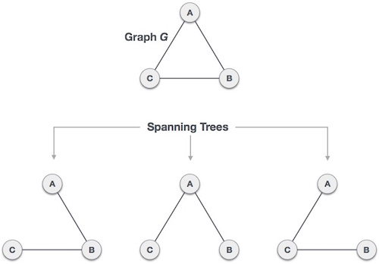
Spanning Tree
Fig 1: Spanning Trees

Slide 4
Properties of Spanning Tree
We now understand that one graph can have more than one spanning tree. Following are a few properties of the spanning tree connected to graph G −
A connected graph G can have more than one spanning tree.
All possible spanning trees of graph G, have the same number of edges and vertices.
The spanning tree does not have any cycle (loops).
Removing one edge from the spanning tree will make the graph disconnected, i.e. the spanning tree is minimally connected.
Adding one edge to the spanning tree will create a circuit or loop, i.e. the spanning tree is maximally acyclic.

Slide 5
Minimum Spanning Tree
In a weighted graph, a minimum spanning tree is a spanning tree that has minimum weight than all other spanning trees of the same graph. In real-world situations, this weight can be measured as distance, congestion, traffic load or any arbitrary value denoted to the edges.

Slide 6
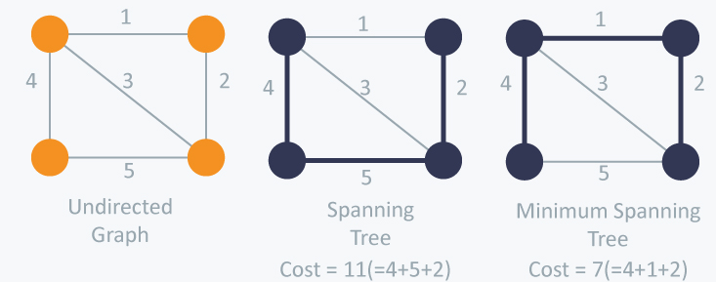
Minimum Spanning Tree
The cost of the spanning tree is the sum of the weights of all the edges in the tree. There can be many spanning trees. Minimum spanning tree is the spanning tree where the cost is minimum among all the spanning trees. There also can be many minimum spanning trees.

Slide 7
Minimum Spanning Tree
Different ways to create Minimum spanning tree:
Prim’s algorithm
Kruskal’s Algorithm

Slide 8
Kruskal’s Algorithm
Kruskal's algorithm to find the minimum cost spanning tree uses the greedy approach. This algorithm treats the graph as a forest and every node it has as an individual tree. A tree connects to another only and only if, it has the least cost among all available options and does not violate MST properties.
The steps for implementing Kruskal's algorithm are as follows:
Sort all the edges from low weight to high.
Take the edge with the lowest weight and add it to the spanning tree. If adding the edge created a cycle, then reject this edge.
Keep adding edges until we reach all vertices.

Slide 9
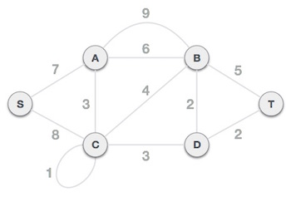
Contd..
Fig 2: Given Graph

Slide 10
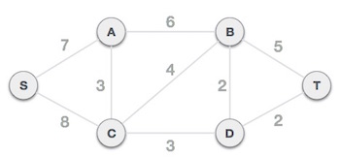
Contd…
Step 1 - Remove all loops and Parallel Edges
Fig 3: Removed loop and parallel edges

Slide 11

Contd…
Step 2 - Arrange all edges in their increasing order of weight
Fig 4: Step 2

Slide 12
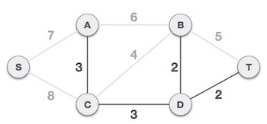
Kruskal’s Method
Step 3: Add the edge which has the least weightage
The least cost is 2 and edges involved are B,D and D,T. We add them. Adding them does not violate spanning tree properties, so we continue to our next edge selection.
Next cost is 3, and associated edges are A,C and C,D. We add them again −
Fig 5: Nest step of Kruskal’s method

Slide 13
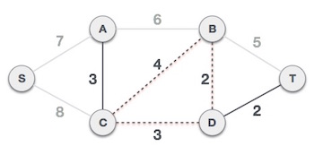
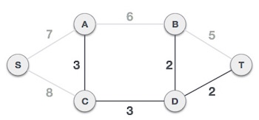
Kruskal’s Method
Step 4: Next cost in the table is 4, and we observe that adding it will create a circuit in the graph. −
We ignore it. In the process we shall ignore/avoid all edges that create a circuit.
Fig 6: Next step of Kruskal’s method

Slide 14
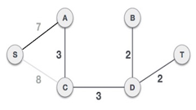
Contd…
We observe that edges with cost 5 and 6 also create circuits. We ignore them and move on.
Now we are left with only one node to be added. Between the two least cost edges available 7 and 8, we shall add the edge with cost 7.
Fig 7: Minimum Spanning Tree

Slide 15
Prim’s Minimum Spanning Tree
How does Prim’s Algorithm Work? The idea behind Prim’s algorithm is simple, a spanning tree means all vertices must be connected. So the two disjoint subsets (discussed above) of vertices must be connected to make a Spanning Tree. And they must be connected with the minimum weight edge to make it a Minimum Spanning Tree.

Slide 16
Prim’s Minimum Spanning Tree
Prim’s Algorithm is a famous greedy algorithm.
It is used for finding the Minimum Spanning Tree (MST) of a given graph.
To apply Prim’s algorithm, the given graph must be weighted, connected and undirected.
Step-01:
Randomly choose any vertex.
The vertex connecting to the edge having least weight is usually selected.
Step-02:
Find all the edges that connect the tree to new vertices.
Find the least weight edge among those edges and include it in the existing tree.
If including that edge creates a cycle, then reject that edge and look for the next least weight edge.
Step-03:
Keep repeating step-02 until all the vertices are included and Minimum Spanning Tree (MST) is obtained.

Slide 17
Prim’s Algorithm
1) Create a set mstSet that keeps track of vertices already included in MST.
2) Assign a key value to all vertices in the input graph. Initialize all key values as INFINITE. Assign key value as 0 for the first vertex so that it is picked first.
3) While mstSet doesn’t include all vertices
….a) Pick a vertex u which is not there in mstSet and has minimum key value.
….b) Include u to mstSet.
….c) Update key value of all adjacent vertices of u. To update the key values, iterate through all adjacent vertices. For every adjacent vertex v, if weight of edge u-v is less than the previous key value of v, update the key value as weight of u-v

Slide 18
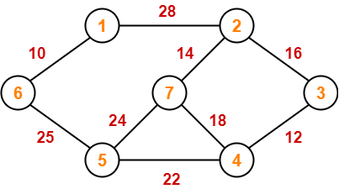
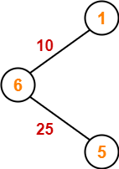
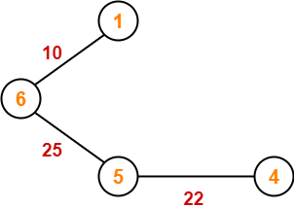
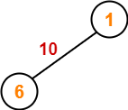
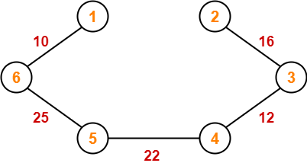
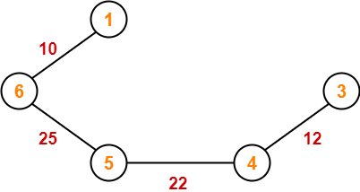
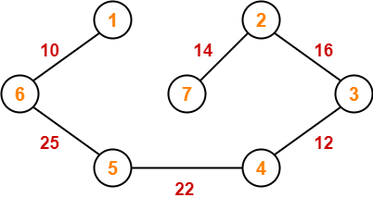
Prim’s Method
Since all the vertices have been included in the MST, so we stop.
Now, Cost of Minimum Spanning Tree
= Sum of all edge weights
= 10 + 25 + 22 + 12 + 16 + 14
= 99 units

Slide 19
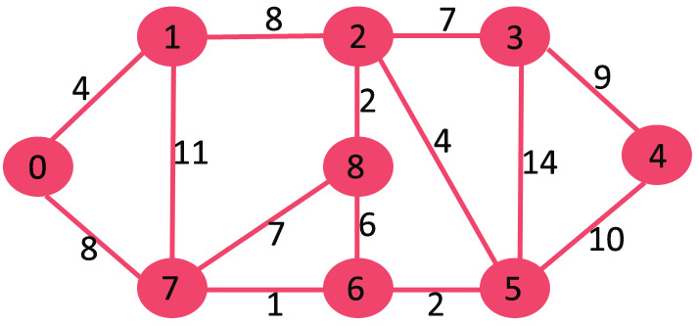
Prim’s Method
Fig 3: Graph

Slide 20

Contd…
The vertices included in MST are shown in green color.
Fig 4: Step 1

Slide 21
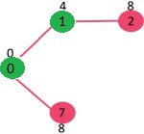
Contd…
Pick the vertex with minimum key value and not already included in MST (not in mstSET). The vertex 1 is picked and added to mstSet. So mstSet now becomes {0, 1}. Update the key values of adjacent vertices of 1. The key value of vertex 2 becomes 8.
Fig 5: Step 2 of Prim’s method

Slide 22
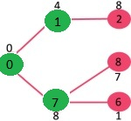
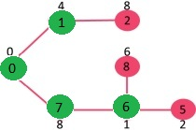
Minimum Spanning Tree
Fig 6: Step 3 of Prim’s method

Slide 23
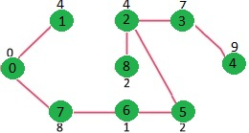
Minimum Spanning Tree
We repeat the above steps until mstSet includes all vertices of given graph. Finally, we get the following graph.
Fig 7: Minimum Spanning Tree

Slide 24
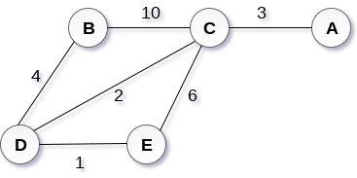
Minimum Spanning Tree
Create minimum spanning tree using Prim’s Method.
Fig 8: Minimum Spanning Tree

Slide 25
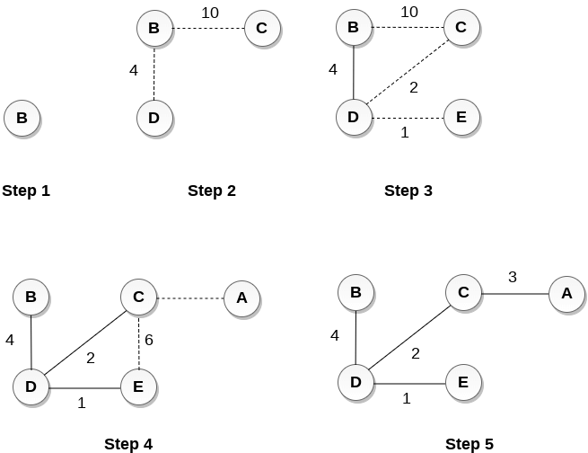
Minimum Spanning Tree

Slide 26
References
[1] https://www.tutorialspoint.com/data_structures_algorithms/images/spanning_trees.jpg
[2] https://www.tutorialspoint.com/data_structures_algorithms/images/spanning_trees.jpg
[3] https://www.geeksforgeeks.org/wp-content/uploads/Fig-11.jpg
[4] https://www.geeksforgeeks.org/wp-content/uploads/MST1.jpg
[5] https://www.geeksforgeeks.org/wp-content/uploads/MST1.jpg
[6] https://www.geeksforgeeks.org/wp-content/uploads/MST1.jpg
[7] https://www.geeksforgeeks.org/wp-content/uploads/MST1.jpg
Books:
Introduction to Algorithms by Coreman, Leiserson, Rivest, Stein.
Fundamentals of Algorithms by Ellis Horwitz, Sartaj Sahni, Sanguthevar Rajasekaran

Slide 27
THANK YOU
For any Queries-
E-Mail: gurpreetkaur.uic@cumail.in

